Slide 1
ECE 419/619, Electric Machines and Drives Dr. Keith Corzine

Slide 2
Some Electric Drive System Applications

Slide 3
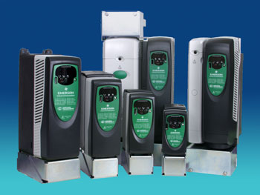
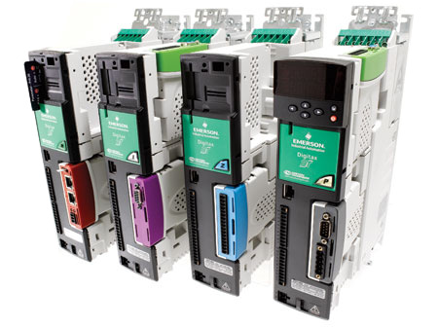
Typical Industrial Drives
Notes:
Used in numerous industries. May be a steel plant, a food processing plant, an aircraft manufacturer, etc. These industries need punches, machine tools, conveyers, overhead cranes, etc.

Slide 4
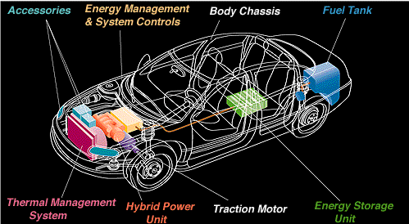
Hybrid Vehicles
Notes:
Electric motors are one of the oldest areas in electrical engineering; dating back to the 1800’s. However, there are numerous new applications such as hybrid vehicles, wind turbines, etc.

Slide 5
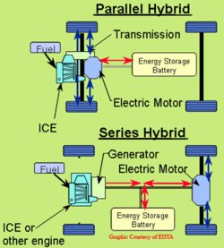
Parallel and Series Hybrids

Slide 6
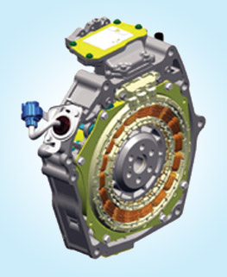
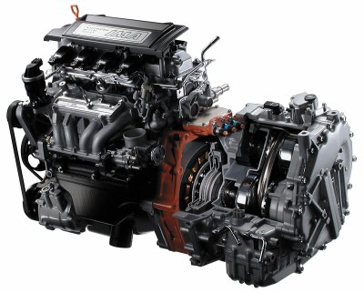
Hybrid Vehicle Motors

Slide 7
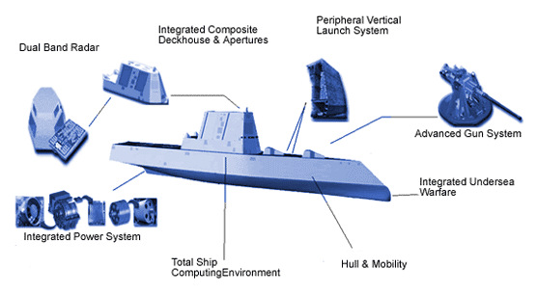
Electric Ship Applications
Notes:
The Electric ship is a large hybrid vehicle (which us usually the series type).

Slide 8
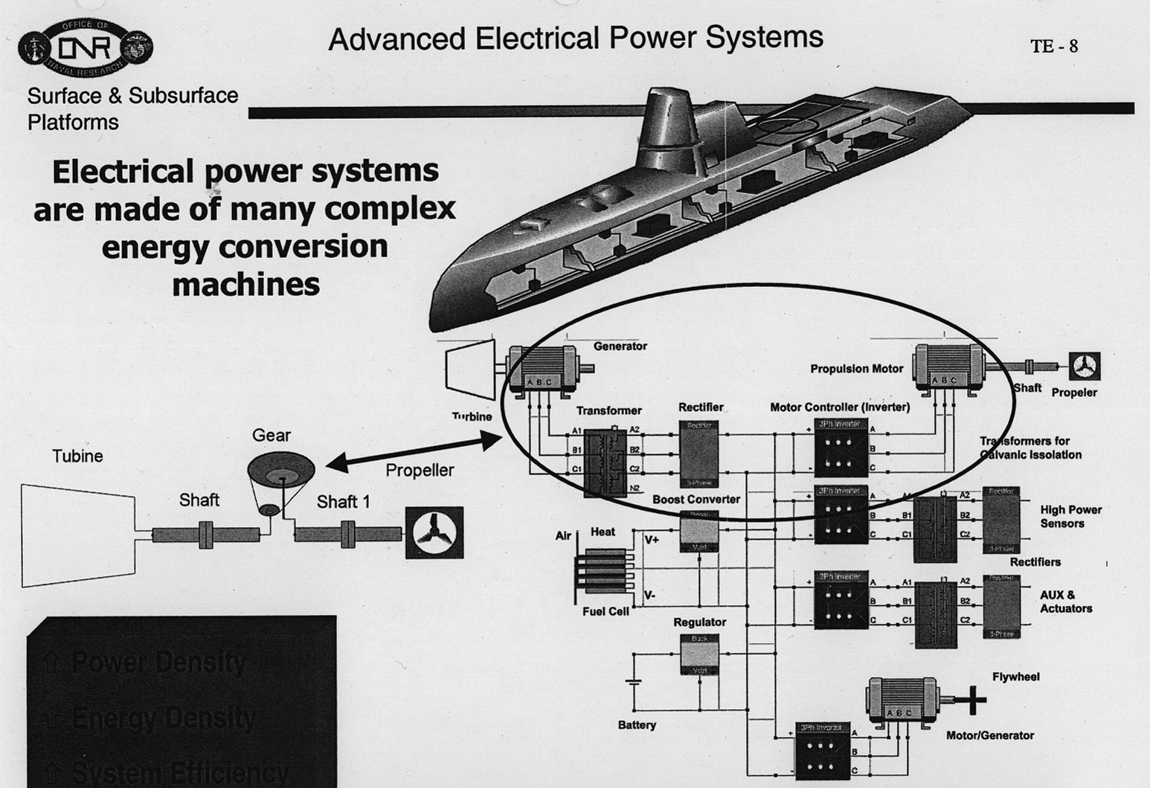

Slide 9
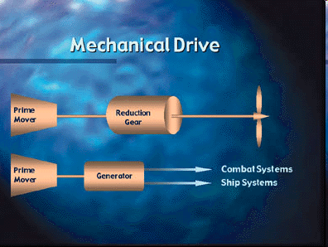
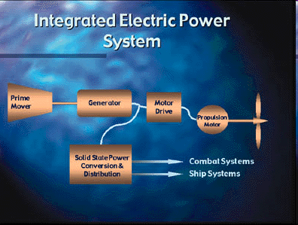
Electric Ship Power System
http://www.navy.mil/navydata/cno/n87/usw/issue_9/power_system.html

Slide 10
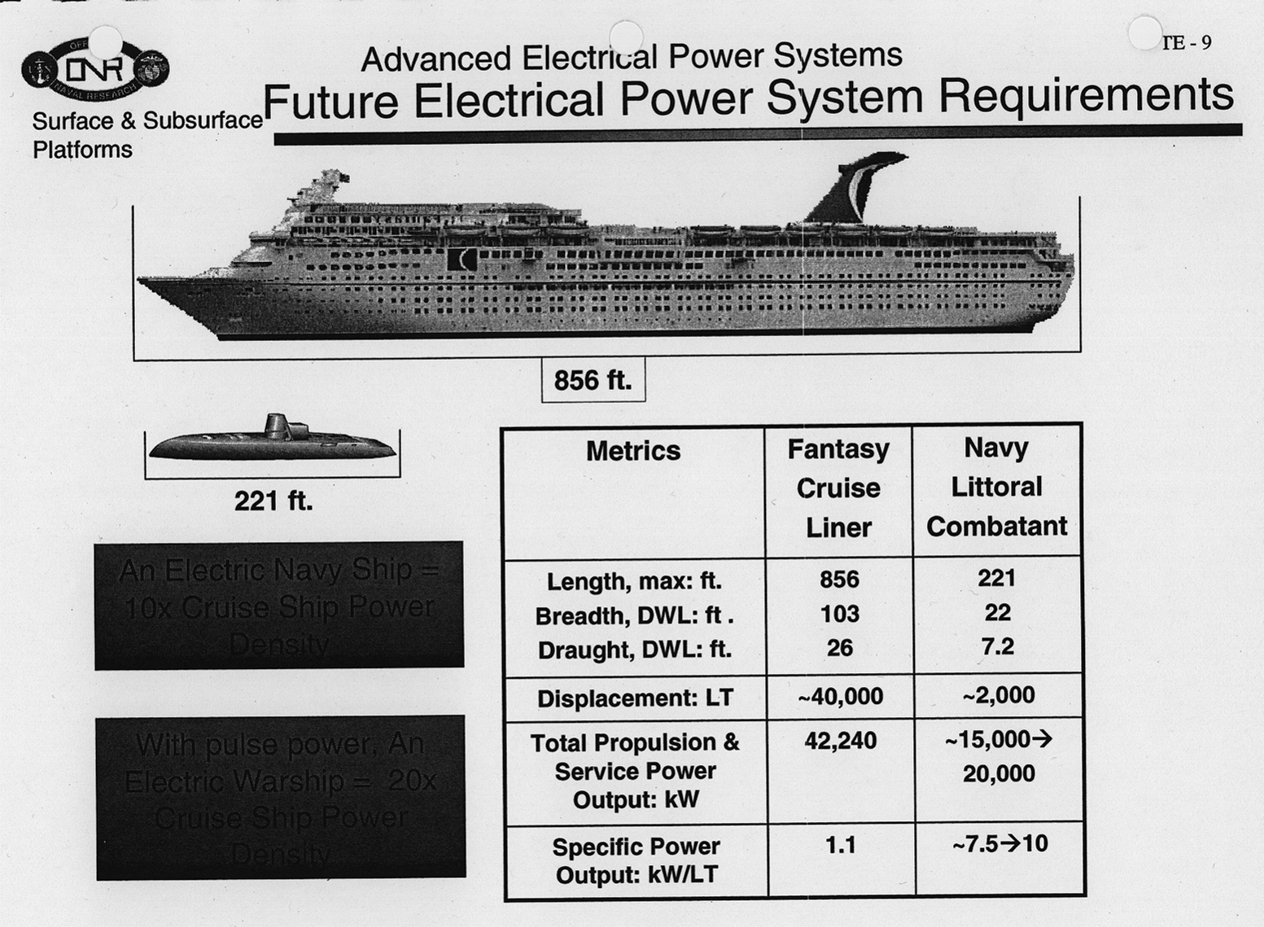

Slide 11
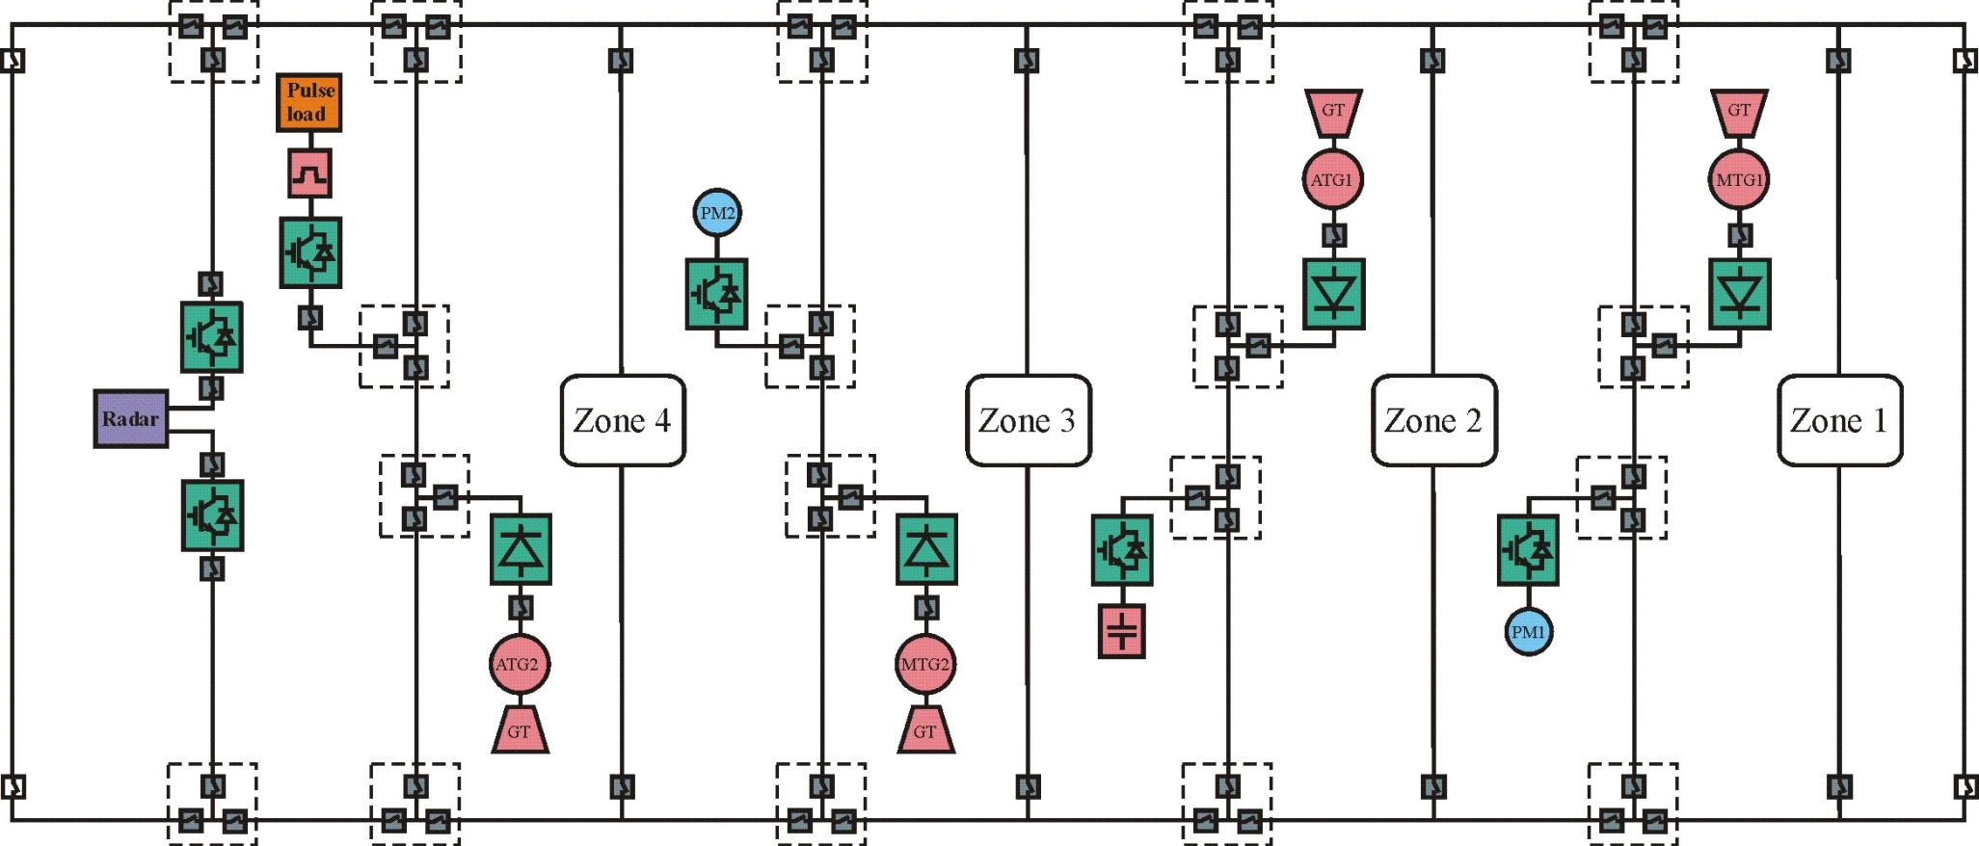
MVDC System

Slide 12
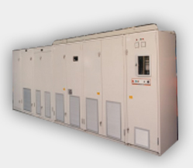
Propulsion Motor Drive
http://www.converteam.com/converteam/1/image/Services/Service/Service_UK/IMDrive_CIMDrive.jpg

Slide 13
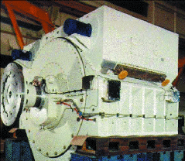
Propulsion Motor 19MW
http://navy-matters.beedall.com/images/20mw.gif

Slide 14
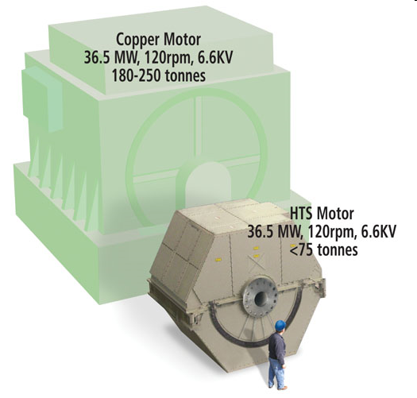
DDG-1000 Propulsion Motors
http://www.amsc.com/images/products/ONR_motor%20COMP_0707.jpg

Slide 15
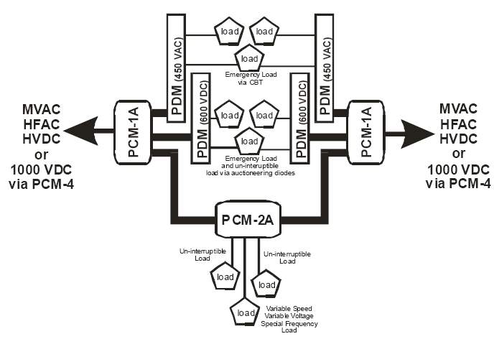
Integrated Fight Through Power (IFTP)
Ship service power (low-voltage, 450Vac)
Medium- to low-voltage conversion
https://www.neco.navy.mil/synopsis_file/N00024NGIPS_Technology_Dev_Roadmap_final_Distro_A.pdf

Slide 16
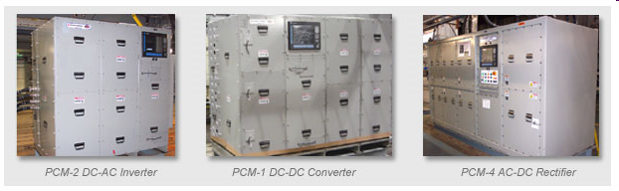
IFTP Power Conversion
PCM-1, dc-dc power converter
PCM-2, dc-ac power converter
PCM-4, ac-dc power converter
http://www.ga.com/atg/EMS/images/iftp-2.jpg

Slide 17
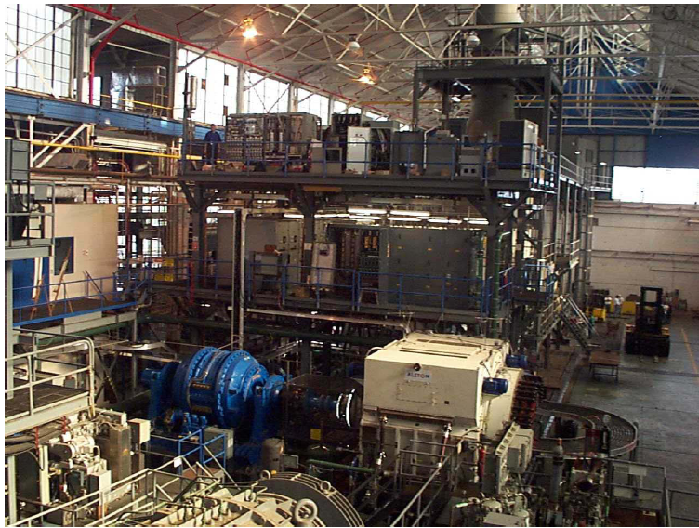
IPS Test Site
M. Collins, DD(X) IPS Revolution in Shipboard Power, 2003

Slide 18
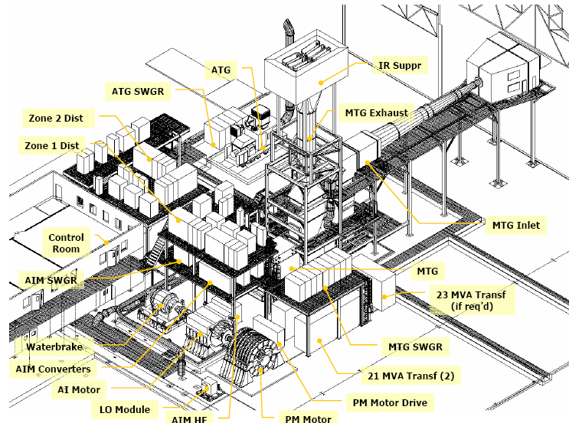
IPS Test Site Layout
M. Collins, DD(X) IPS Revolution in Shipboard Power, 2003

Slide 19
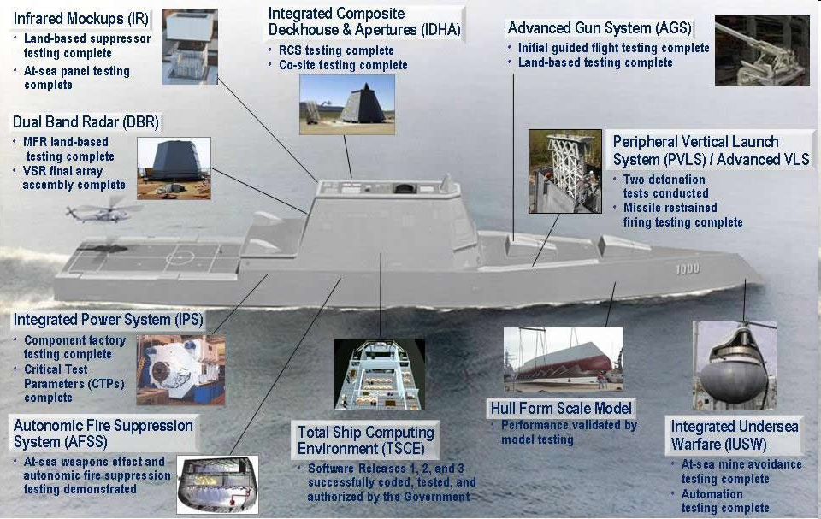
DDG-1000 Program
http://www.defenseindustrydaily.com/images/SHIP_DDG-1000_Critical_Tech_Status_2006_lg.jpg

Slide 20
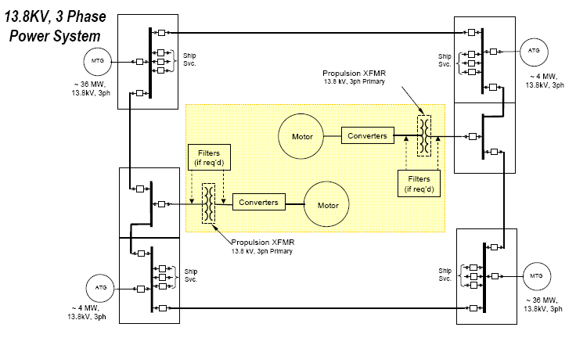
MVAC System
M. Collins, DD(X) IPS Revolution in Shipboard Power, 2003

Slide 21
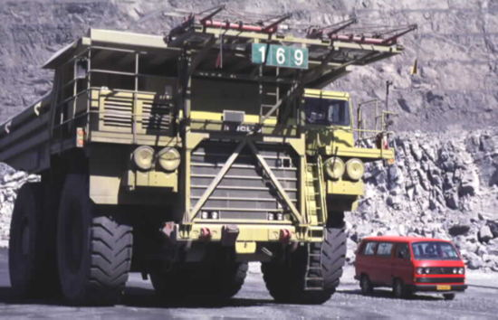
Electric Mining Trucks
One of the haul trucks fitted with a pantograph for the trolley-assist system, which uses electric power from the main grid to move the trucks up the steep pit ramps.
Notes:
Most people think that these trucks are diesel because of the smoke stack, but they are actually electric driven. Resistors are used for braking instead of friction breaks. This one has a trolley rig fit to provide electric power directly to the motor drives. Caterpillar in Peoria is now making drives for large mining vehicles.

Slide 22

Electric Shovel and Truck
Electric shovels load the broken material into trucks for transport from the pit. Initial pit equipment included shovels with 11 cubic yard buckets and 85 ton production trucks. For the 1990s, the mine is converting its fleet to 170 and 190 ton trucks.
Notes:
I worked on retrofitting the electric shovel with new drives. There are six drives; one for the swing motion, two for the crowd motion, and three for the hoist motion.

Slide 23
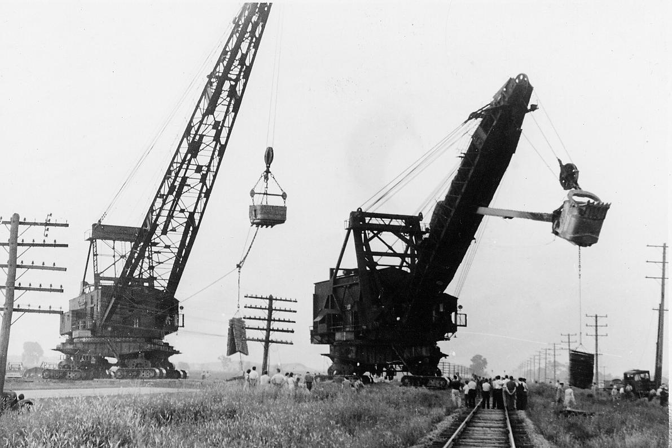
Dragline and Shovel
Mucker and drag line crossing the rail road between Godley and Braidwood. July 16, 1941. Douglass-Edwards Camera Shop, Joliet.

Slide 24
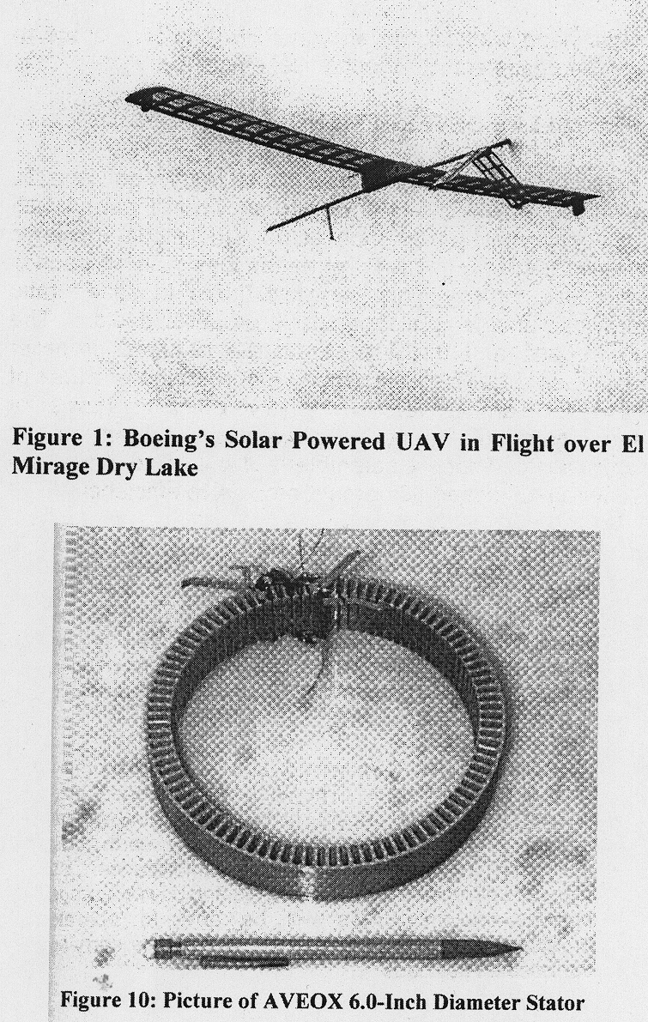
Unmanned Aerial Vehicle
D. Palombo and G.D. Miller, "A High Efficiency Electric Motor Propeller Propulsion System for Solar Powered UAV's," SAE Aerospace Power Systems Conference, volume P-322, pages 127-132, 1998.

Slide 25
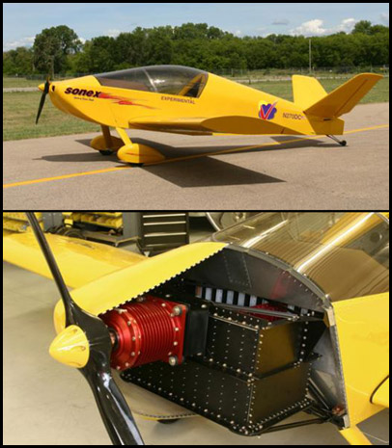
Manned Aerial Vehicle
Sonex Aircraft
E-Flight Initiative
Brushless dc motor
efficiency: 96%
motor weight: 50 lbs.
flight time: 1 hr.
motor power: 100 hp.
voltage: 270 Vdc

Slide 26
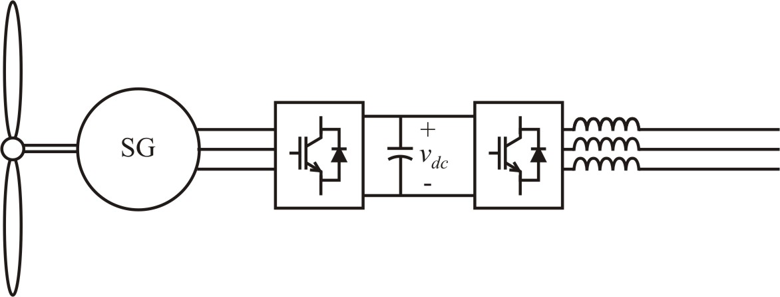
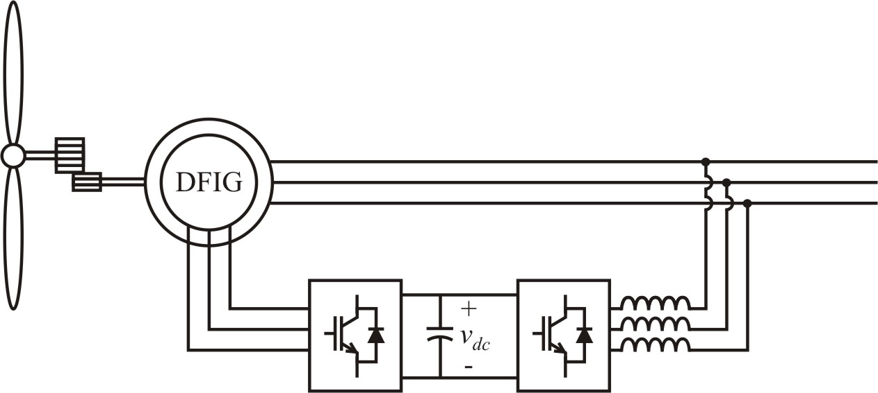
Wind Power Generation
direct-drive synchronous generator
dual-fed induction generator (DFIG)

Slide 27
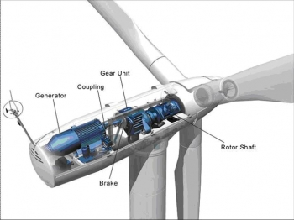
Wind Turbine Diagram

Slide 28
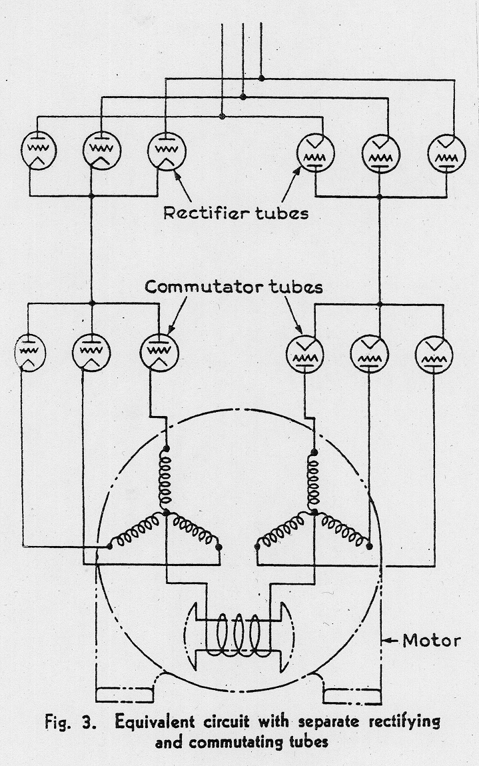
Thyratron Motor
Built by
General Electric
in 1934
4000V
400hp (≈300kW)

Slide 29
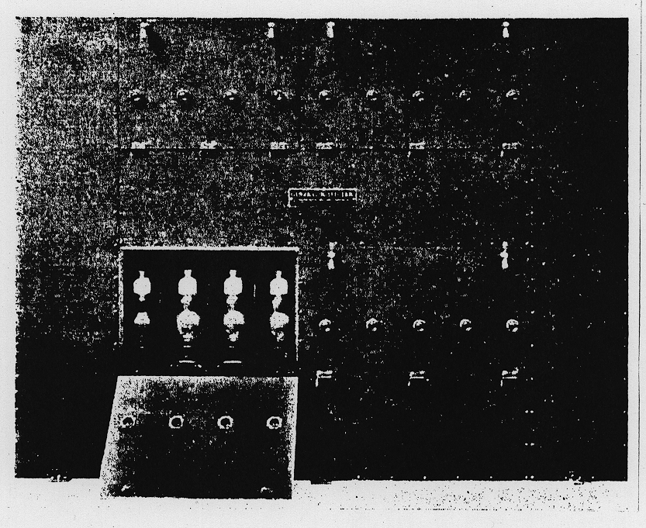
Thyratron Control Cabinet

Slide 30
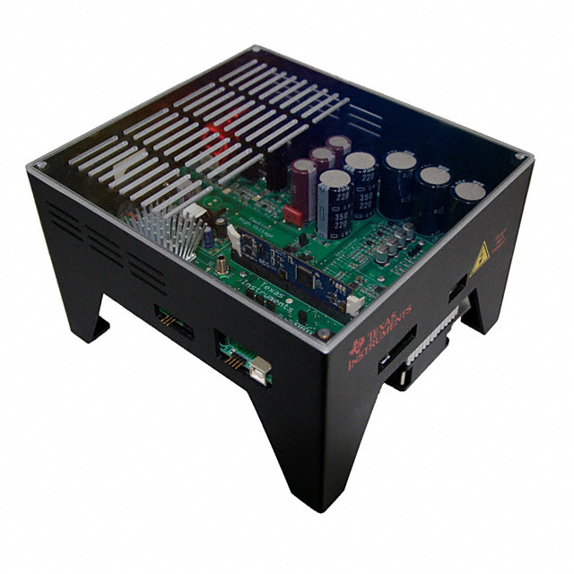
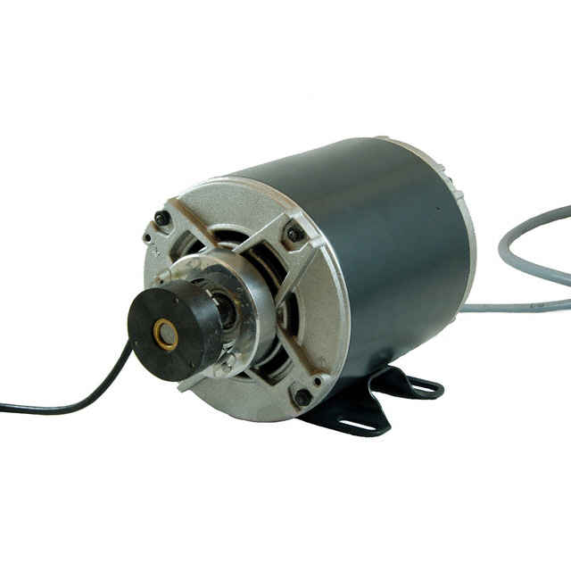
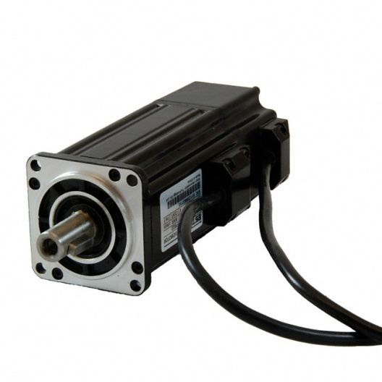
Texas Instruments TMDSHVMTRPFCKIT - High Voltage PFC and Motor Control Developer's Kit
Diode rectifier or power factor controlled input
Up to 1.5 kW
Drive: $622
Induction motor: $310
Permanent-magnet synchronous motor: $355
Brushless dc motor: $207

Slide 31
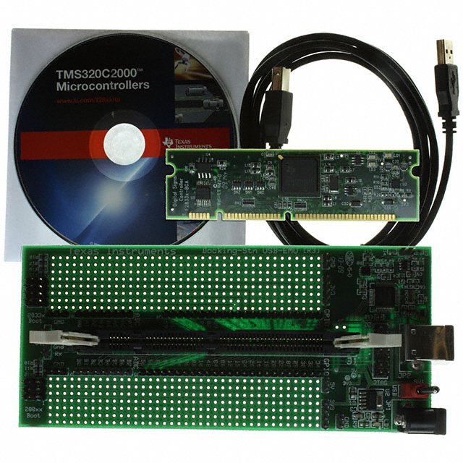
TI TMS320F28335 Digital Signal Processor
Floating point CPU (32-bit)
On-board clock (150 MHz)
Sixteen (16) 12-bit analog inputs
Sixty four (64) general purpose digital I/O
PWM and timer outputs
Serial connections (2 CAN, 3 SCI, 2 McBSP)
On-chip memory (Flash and SRAM)
Boot ROM
DSP board: $60.00
Docking station: $40.00
Code Composer v3.3: $0.00
From Digi-Key: 296-23544-ND

Slide 32
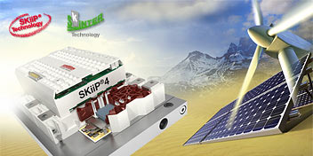
Semikron SKiiP IPM
Three-phase IGBT drive package with integrated gate drives
Voltage ratings of 1200V or 1700V
Current ratings from 500A to 2400A

Slide 33
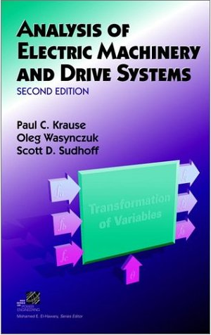
Book and Software
Suggested software
Matlab Simulink, The Mathworks, (required)
PSCAD, Manitoba HVDC Research Centre
PSIM, Powersim Inc.

